Slide 1

Lecture – 10/27/2016
CSCI 36300 – Software Design

Slide 2
Assignment #3
Due:
Phase II Submission
Friday @ 11:59 PM
Reminder:
Ensure that your code in your repo is the code you want me to look at – ensure that the repo is named correctly!
Test your code on Tesla – please run your code.
Make sure you submit a valid MPC file.
Use your Valgrind report as a guide – if there is a memory leak attempt to solve the problem.
Make sure you address my feedback from Phase I.
// FIXED:
Test for both valid and invalid input – make sure you have accounted for common exceptions.

Slide 3
Assignment #4

Slide 4
Assignment #4
Case Study
Calculator
Due Date:
1st Phase Submission:
11/10/2016
Design Patterns:
Composite Pattern
Builder Pattern
Visitor Pattern

Slide 5
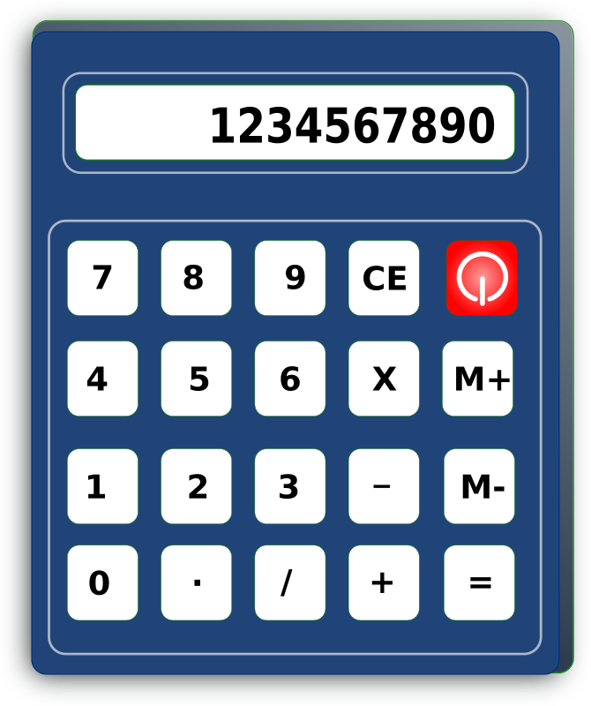
Case Study: Calculator
For this assignment we are going to be using a tree-based structure versus the stack that we used in Assignment #3.
All of the same requirements hold from Assignment #3

Slide 6
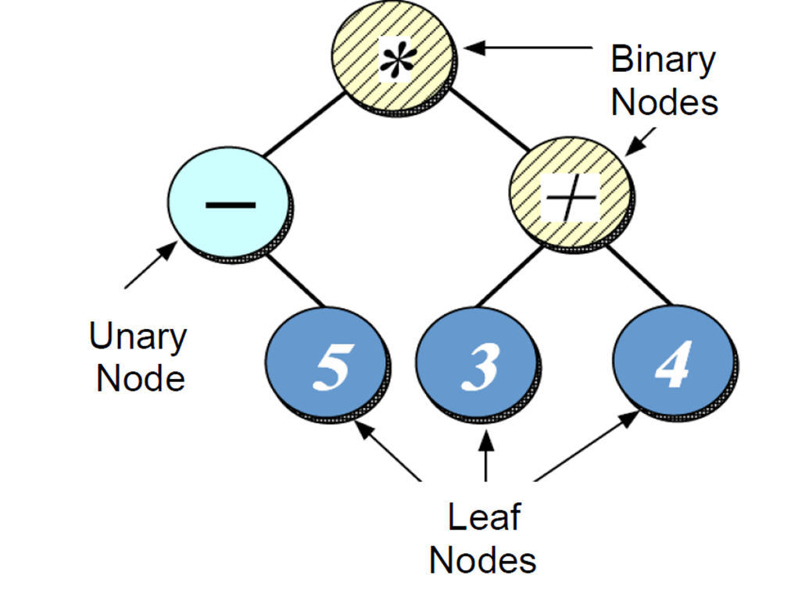
Case Study: Calculator

Slide 7
Assignment #4

Slide 8
Assignment #4 – Hints/Tips
Convert Infix to Binary Expression Tree
Stack can still be utilized.
Composite Pattern
Tree Hierarchy
Builder Pattern
Build the expression tree
Visitor Pattern
Evaluate the expression tree

Slide 9
Quiz #11

Slide 10
Builder Pattern

Slide 11
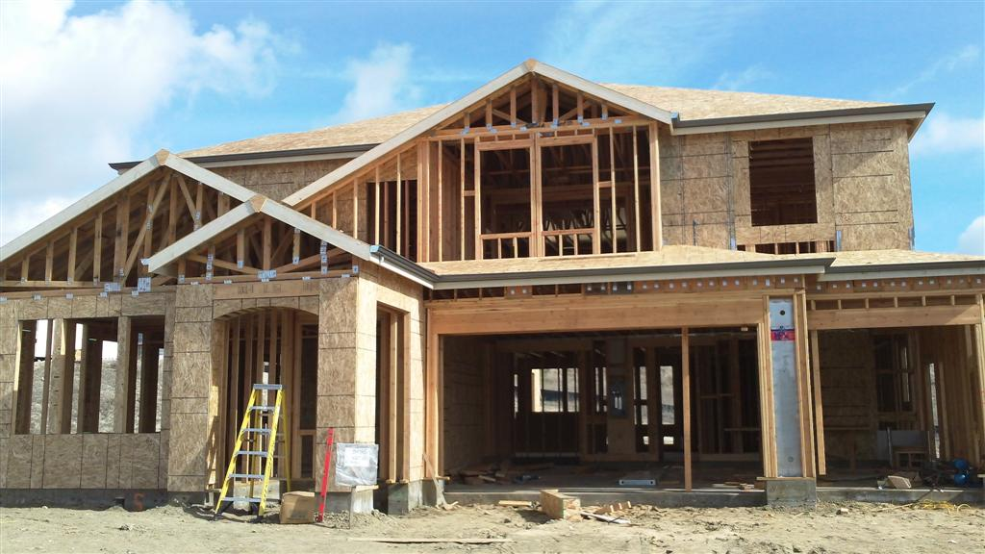
Builder Pattern
Pattern Classification:
Creational
Problem:
Building a complex object but want to shield the client from the complexity.
Solution:
Separate how we construct a complex object from its representation. This shields the client.

Slide 12
Builder Pattern - Motivation
Have you ever been in the following situation:
Need to build a complex object, but want to shield the client from the complexity of building the object.
e.g., Converting an infix expression to a binary tree.
Have many ways of building the same abstraction, but with different internal representations.
e.g., postfix vs. binary tree representation of a infix expression.

Slide 13
Builder Pattern
Analogy:
Each “builder” has their own method/approach for constructing a home.
The homeowner, however, does not care how the home is constructed.
The homeowner just wants their home built as promised.
How can we translate this analogy to the software domain?

Slide 14
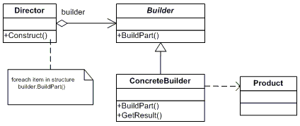
Builder Pattern

Slide 15
Builder Pattern
Let’s revisit our food analogy:
Kids meals typically consist of a main item, a side item, a drink, and a toy.
There may be variations of the content contained in the meal, but the construction process is the same.
The same process is used across various restaurant chains.
Here we shield the customer from knowing how the meal is assembled – only care that it is assembled how they desired.

Slide 16
Builder Pattern
Creational Patterns
We can use other patterns in order to actually “build” the components
Builder vs. Abstract Factory
Builder focuses on constructing a complex object step-by-step.
Abstract Factory emphasizes a family of related products – these can be complexed or not.

Slide 17
Builder Pattern
Builder pattern often is used in conjunction with the Composite pattern.
Start with the Factory pattern – transition to the Abstract Factory pattern – and end up with the Builder pattern.
Intent of pattern in that case is really to address an anti-pattern.
We will address anti-patterns later in the semester.

Slide 18
Builder Pattern
Converting the index expression to a binary tree to is a non-trivial task.
How do we convert the following expression into nodes in a binary tree?
-5 * (3 + 4)
How can we shield the client from the process of creating a binary tree from an infix expression, and support other representations of the infix expression, such as a postfix representation?

Slide 19
Builder Pattern

Slide 20
Builder Pattern
Given the structural design of the expression tree, we can construct a Builder in the form of an interface:
class Expr_Builder {
public:
// ...
virtual void build_expression (void);
virtual void build_number (int n) = 0;
virtual void build_add_operand (void) = 0;
virtual void build_subtract_operand (void) = 0;
// ...
virtual void build_open_parenthesis (void) = 0;
virtual void build_close_parenthesis (void) = 0;
// get the current expression
virtual Math_Expr * get_expression (void) = 0;
};

Slide 21
Builder Pattern
Each method is responsible for building some part of the expression tree without requiring the client (or director) to understand the internal representation of the final expression.
This provides separation of concerns and isolates “things” on a need-to-know basis.
The core functionality is still achieved, just hidden from view.

Slide 22
Visitor Pattern

Slide 23
Visitor Pattern
Have you ever encountered the following scenarios:
Need to traverse a complex structure, but do not want to update the structure to reflect the traversal.
Traversing a Composite.
Have traversal logic that is both complex and must keep track of state during the traversal
Coloring a tree.

Slide 24

Visitor Pattern
Pattern Classification:
Behavioral Pattern
Problem:
You want to perform operations on a class without having to modify the source.
Solution:
Lets you define a new operation without changing the classes of the elements on which it operates.

Slide 25
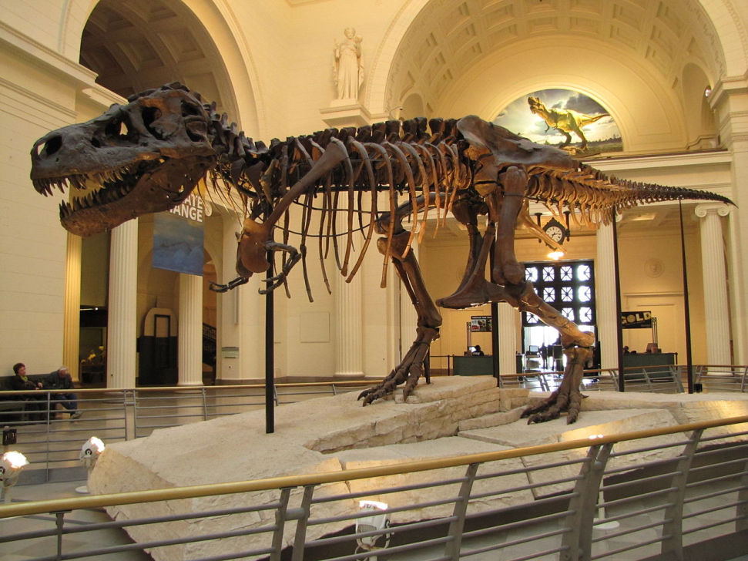
Visitor Pattern
Analogy:
When visiting a museum, how is the museum able to support many different people (i.e., visitation logic) without updating the museum for each person who visits it?
How does it handle this in practice?

Slide 26
Visitor Pattern
Let’s take a look at our Expression Evaluator:
There are many different methods for traversing a tree-structure (e.g., in-order, post-order, pre-order, etc.).
Problem:
How can we provide different methods for traversing the tree without having to update the class definition (or structure) each time?

Slide 27
Visitor Pattern

